Slide 1
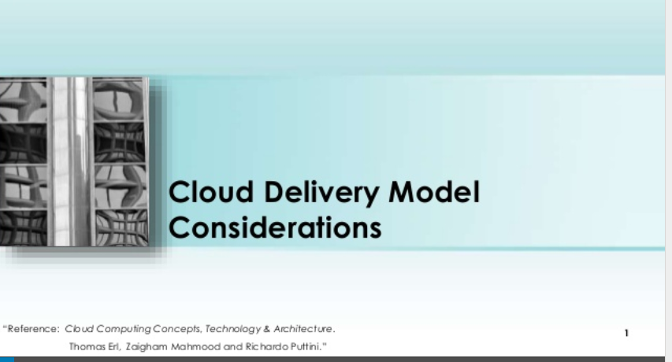

Slide 2
https://www.slideshare.net/SajjadAliMOHAMMED/cloud-delivery-model-considerations

